Slide 1
What is ProGrad?
Each student who attends receives a “gift bundle” that contains several great things for the graduating senior as well as Bulldog Bucks.
Throughout the year, seniors and their volunteer parents can earn extra “Bulldog Bucks” which are needed to purchase raffle tickets for such prizes as luggage, laptops, dorm refrigerators, printers, TVs, MP3 players, docking stations, game systems, cameras, DVD players and much, much more!!
AHS Project Graduation 2018 (ProGrad) is a supervised, all night, drug and alcohol free, celebration for AHS graduating seniors on June 1, 2018! The entire evening is spent on campus with an assortment of food and refreshments, casino night, games, sports activities, entertainment and many, many prizes.

Slide 2
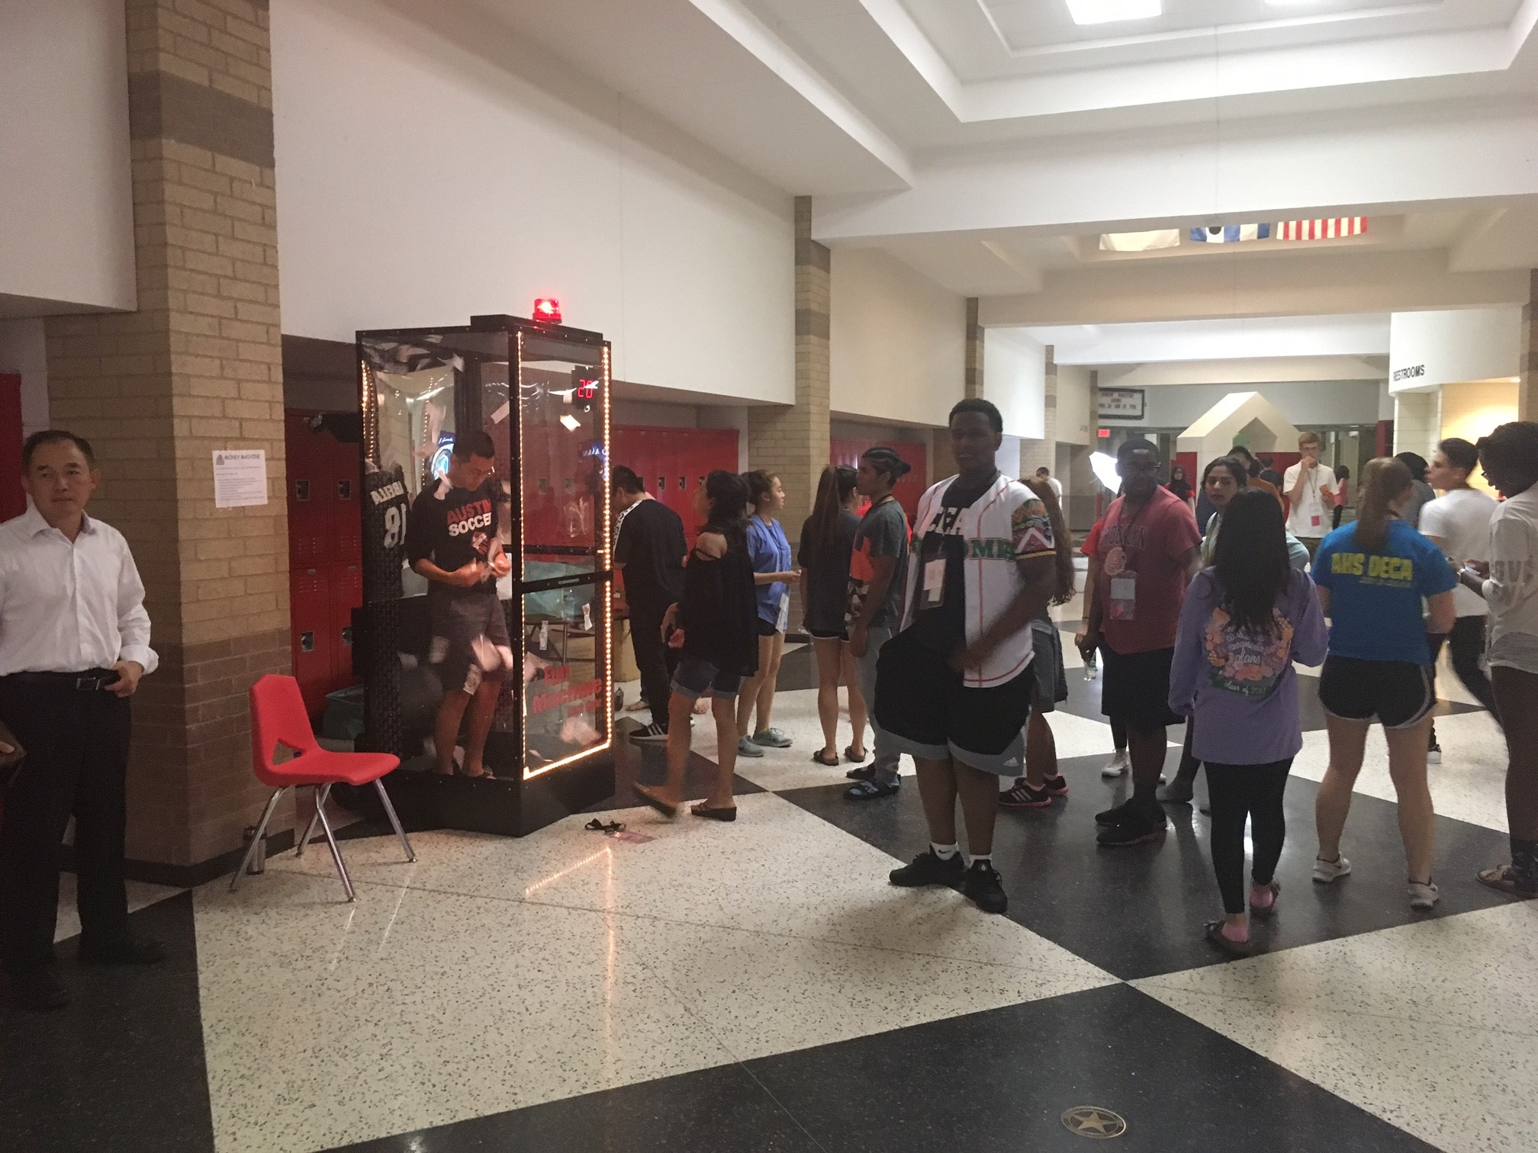

Slide 3
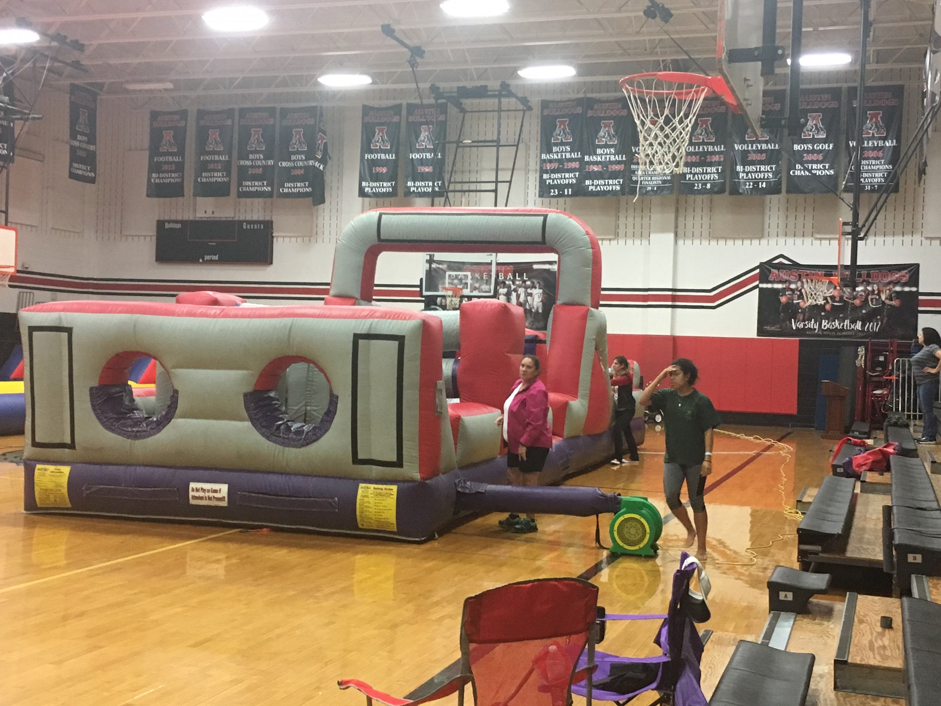

Slide 4
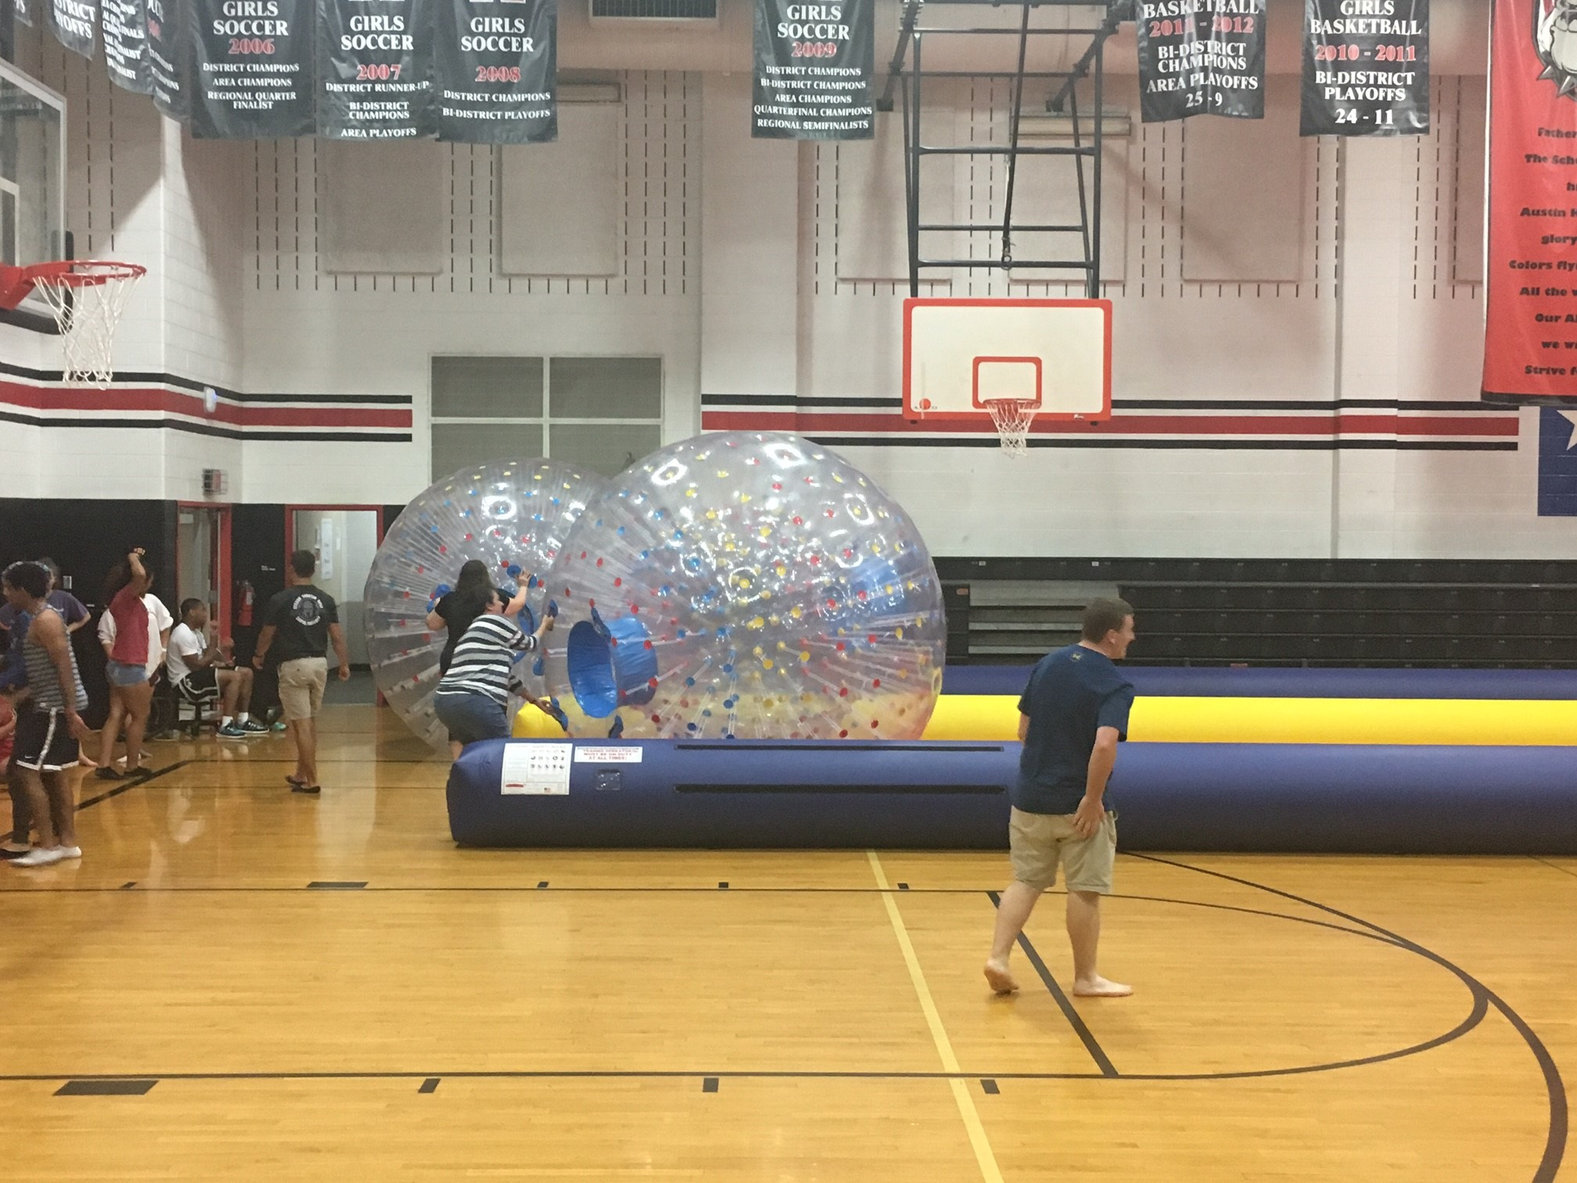

Slide 5
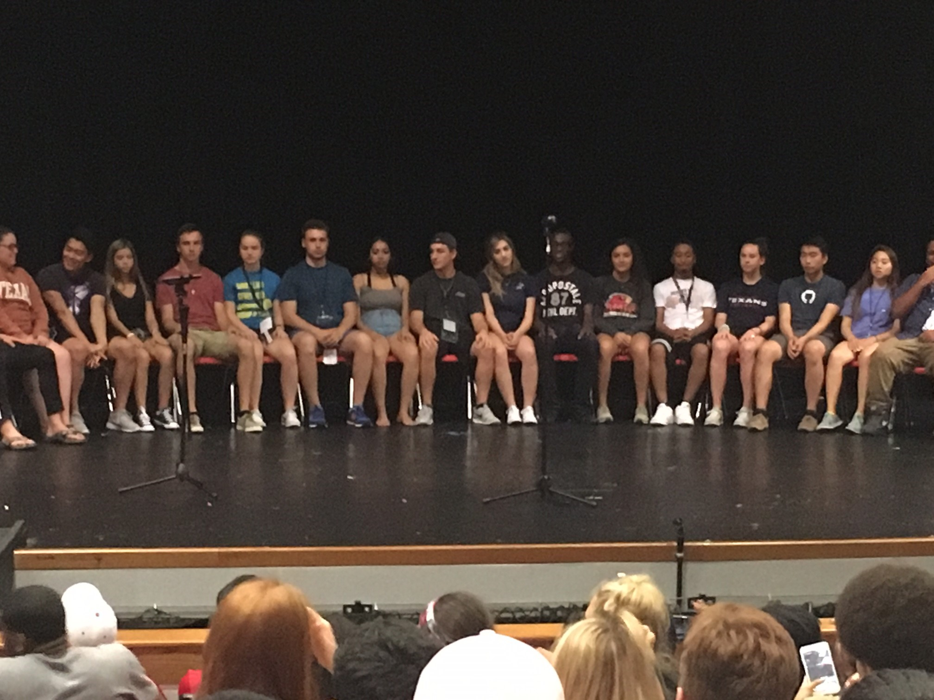

Slide 6
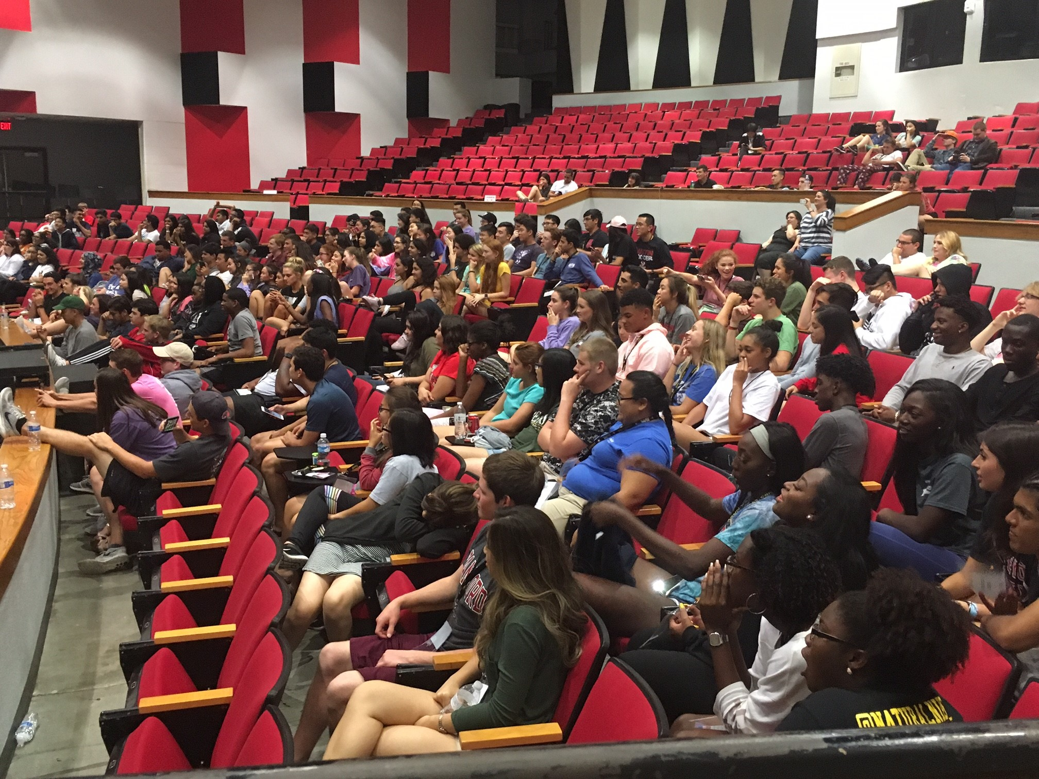

Slide 7
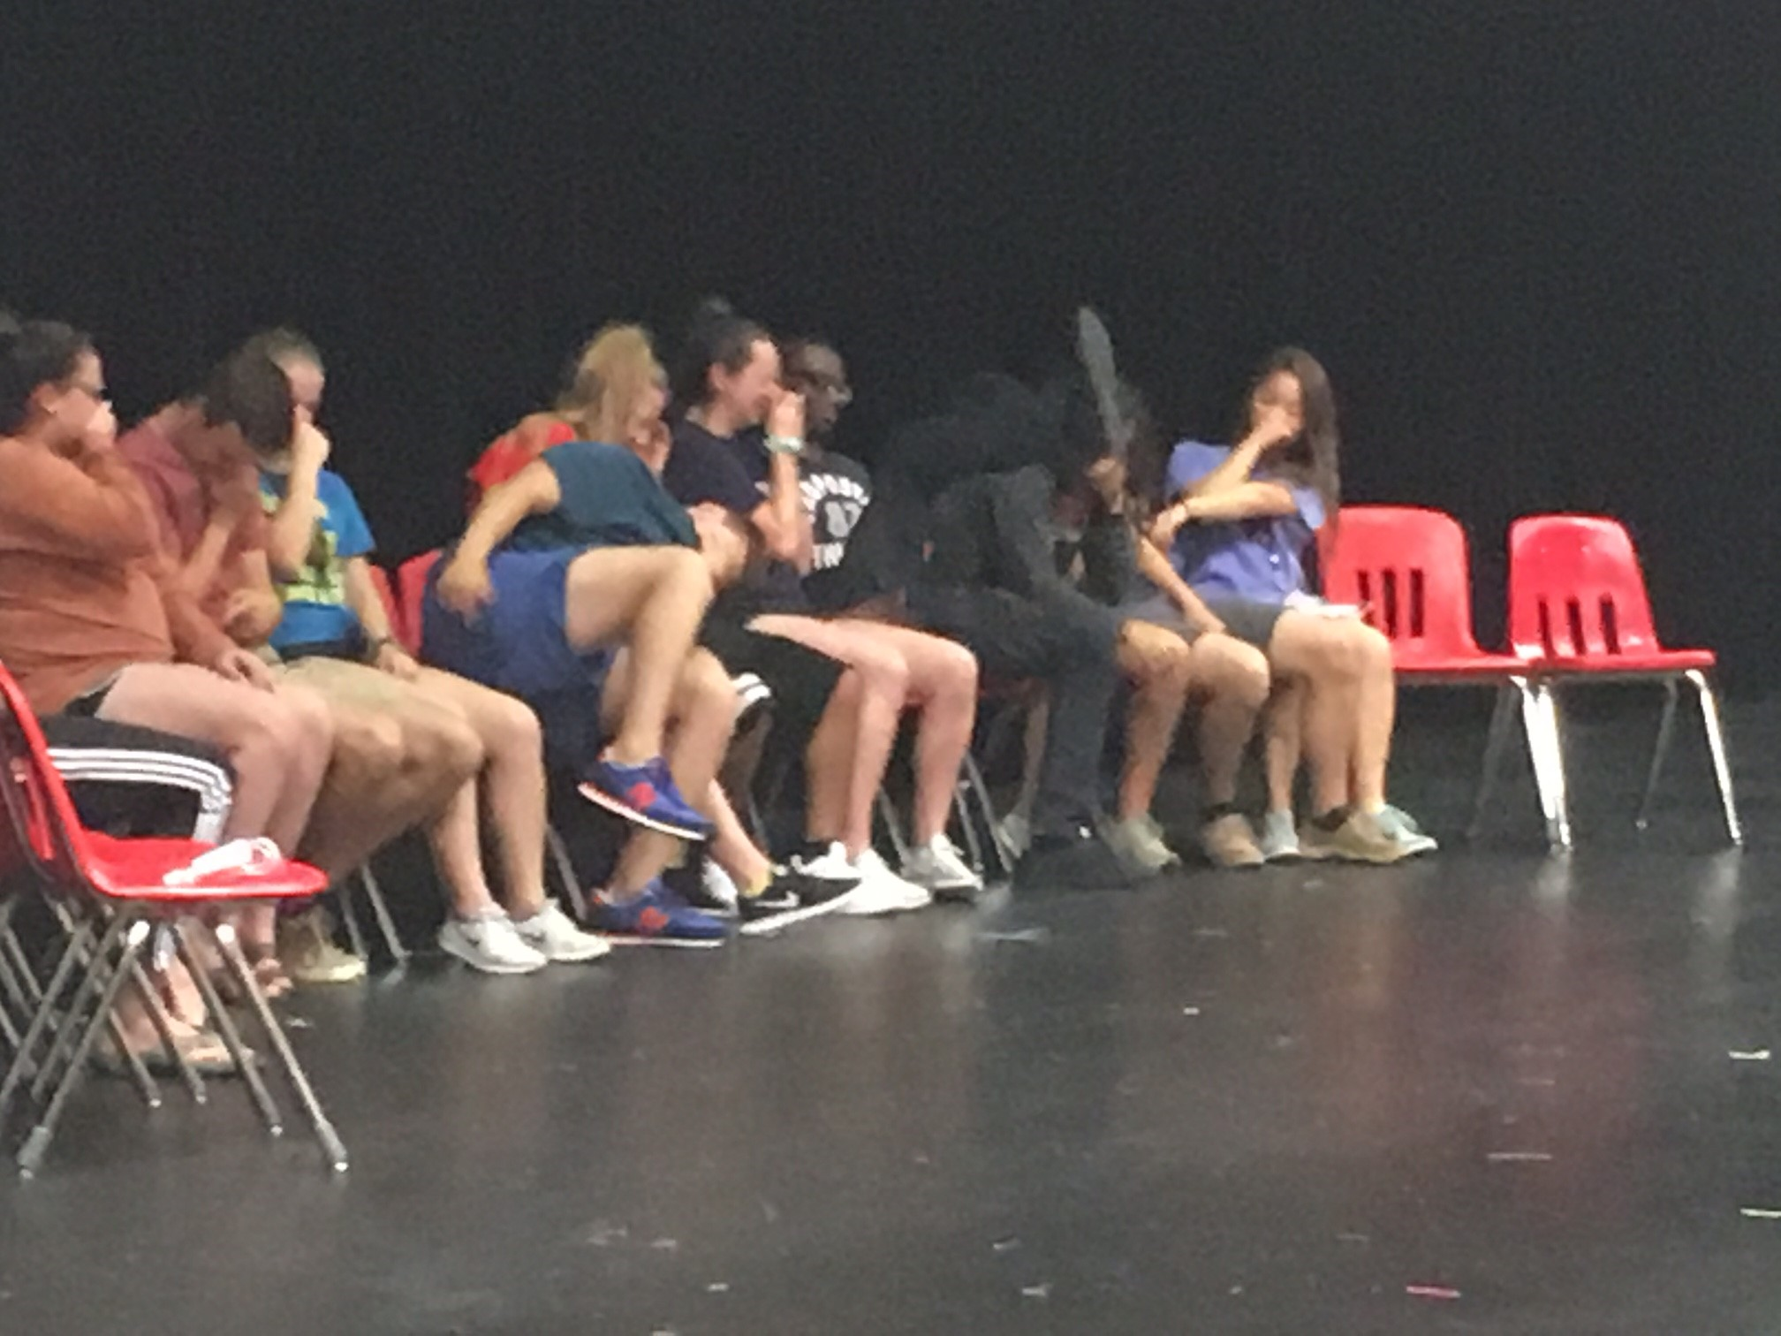

Slide 8
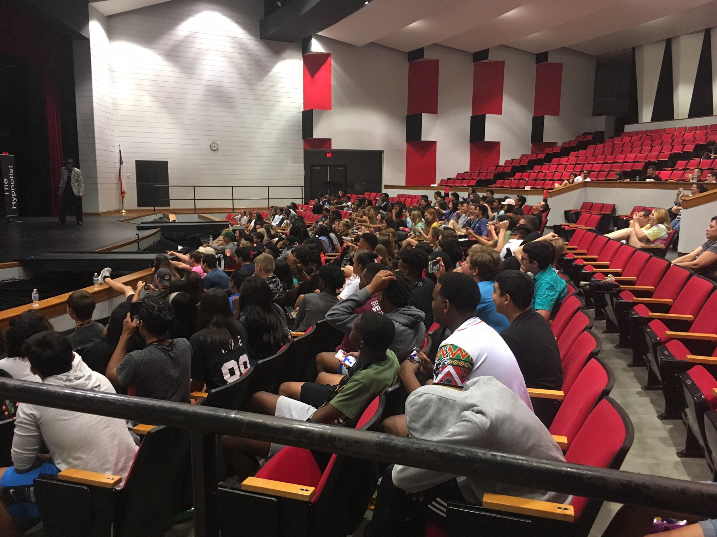

Slide 9
